Slide 1
Ecosystem Dynamics

Slide 2
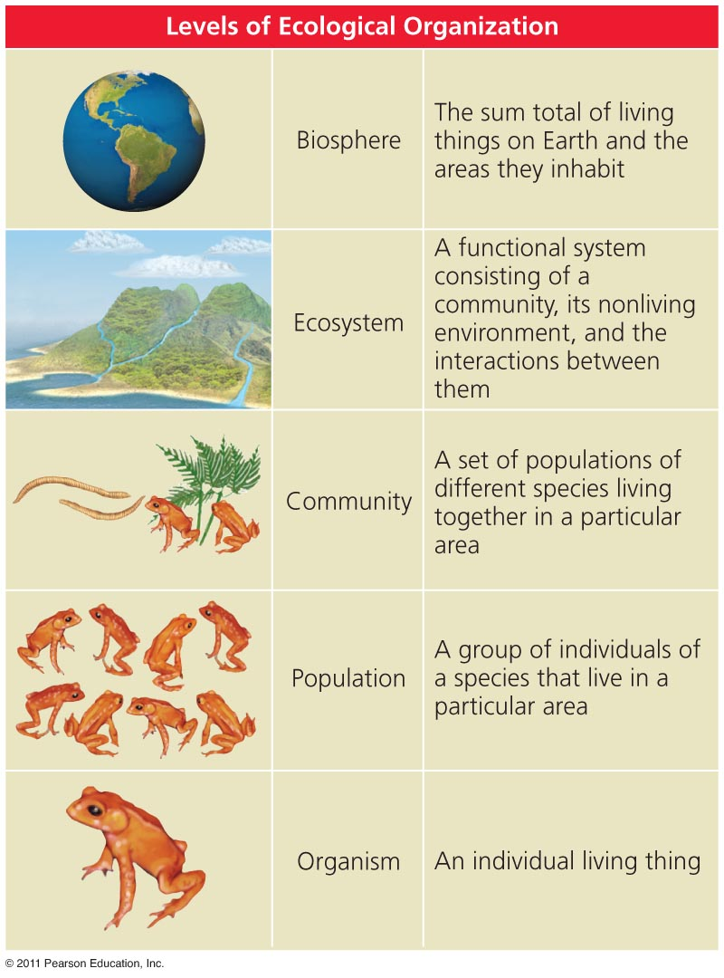
Ecology is studied at several levels
Ecology and evolution are tightly intertwined
Biosphere = the total living things on Earth
  And the areas they inhabit
Community = interacting species living in the same area
Ecosystem = communities and the nonliving material and forces they interact with

Slide 3
Levels of ecological studies
Population ecology = investigates the dynamics of population change
  The factors affecting the distribution and abundance of members of a population
  Why some populations increase and others decrease
Community ecology = focuses on patterns of species diversity and interactions
Ecosystem ecology = studies living and nonliving components of systems to reveal patterns
  Nutrient and energy flows

Slide 4
Each organism has habitat needs
Habitat = the environment where an organism lives
  It includes living and nonliving elements
Habitat use = each organism thrives in certain habitats, but not in others
  Results in nonrandom patterns of use
Habitat selection = the process by which organisms actively select habitats in which to live
  Availability and quality of habitat are crucial to an organism’s well-being
  Human developments conflict with this process

Slide 5
Organismal ecology: niche
Niche = an organism’s use of resources
  Along with its functional role in a community
  Habitat use, food selection, role in energy and nutrient flow, interactions with other individuals
Specialists = have narrow niches and specific needs
  Extremely good at what they do
  But vulnerable when conditions change
Generalists = species with broad niches
  They use a wide array of habitats and resources
  They can live in many different places

Slide 6
Species interactions
Species interactions are the backbone of communities
Natural species interactions:
  Competition = both species are harmed
  Exploitative = one species benefits and the other is harmed
    Predation, parasitism, and herbivory
  Mutualism = both species benefit

Slide 7
Competition
Competition = multiple organisms seek the same limited resources
  Food, space, water, shelter, mates, sunlight
Intraspecific competition = between members of the same species
  High population density = increased competition
Interspecific competition = between members of 2 or more species
  Strongly affects community composition
  Leads to competitive exclusion or species coexistence

Slide 8
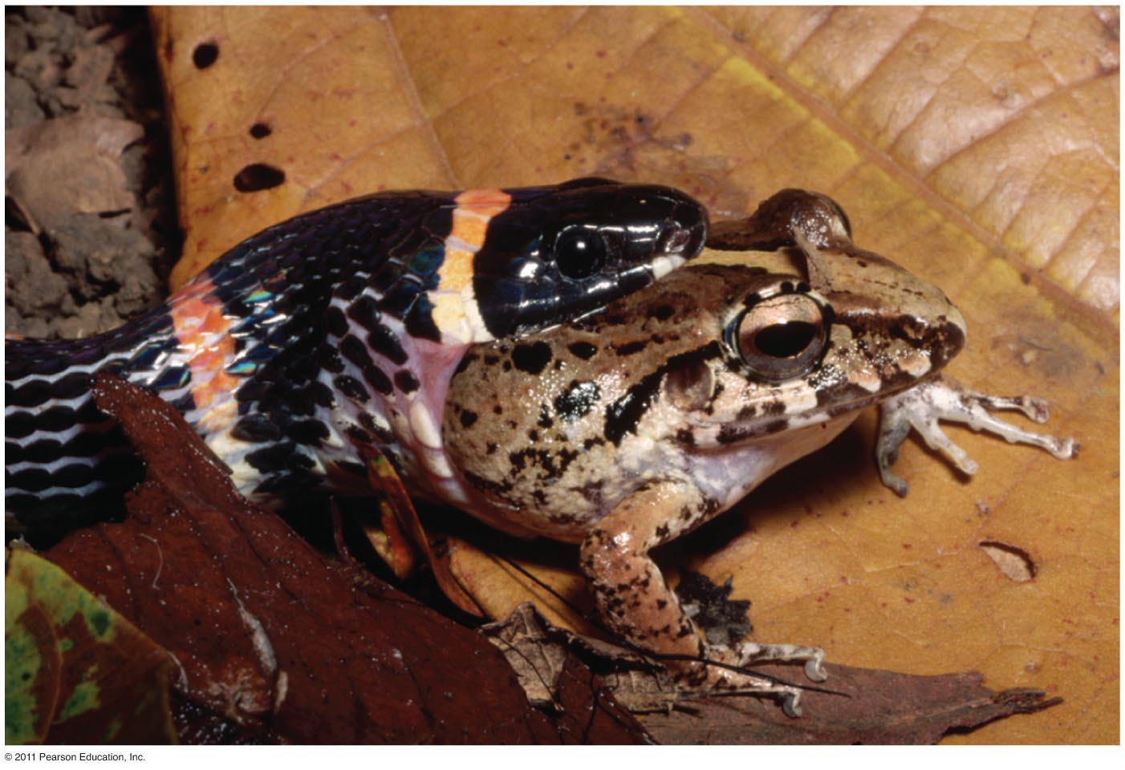
Exploitation: predation
Exploitation = one member exploits another for its own gain (+/- interactions)
  Predation, parasitism, herbivory
Predation = process by which individuals of one species (predators) capture, kill, and consume individuals of another species (prey)
  Structures food webs
  The number of predators and prey influences community composition

Slide 9
Zebra mussel predation on phytoplankton
Zebra mussels eat phytoplankton and zooplankton
  Both populations decrease in lakes with zebra mussels
Zebra mussels don’t eat cyanobacteria
  Population increases in lakes with zebra mussels
Zebra mussels are becoming prey for some North American predators:
  Diving ducks, muskrats, crayfish, flounder, sturgeon, eels, carp, and freshwater drum

Slide 10
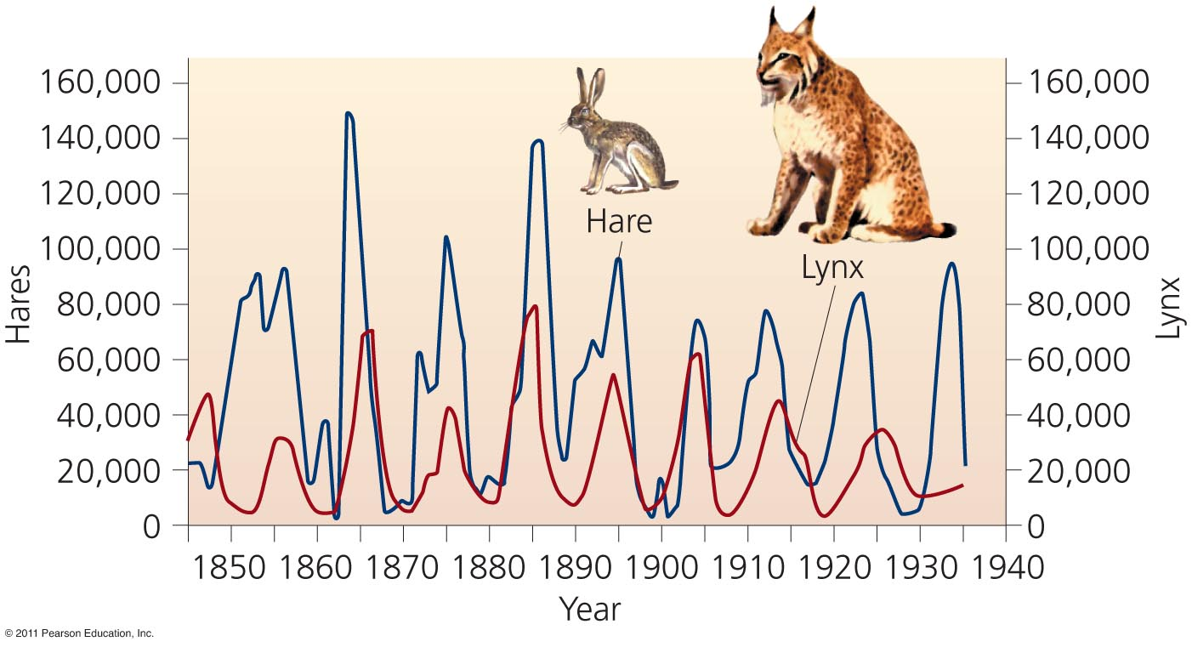
Effects of predation on populations
Increased prey populations increase predators
  Predators survive and reproduce
Increased predator populations decrease prey
  Predators starve
Decreased predator populations increase prey populations

Slide 11
Predation has evolutionary ramifications
Natural selection leads to evolution of adaptations that make predators better hunters
Individuals who are better at catching prey:
  Live longer, healthier lives
  Take better care of offspring
Prey face strong selection pressures: they are at risk of immediate death
  Prey develop elaborate defenses against being eaten

Slide 12
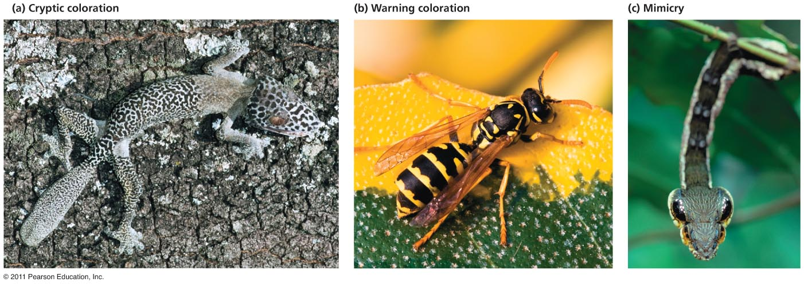
Defenses against being eaten

Slide 13
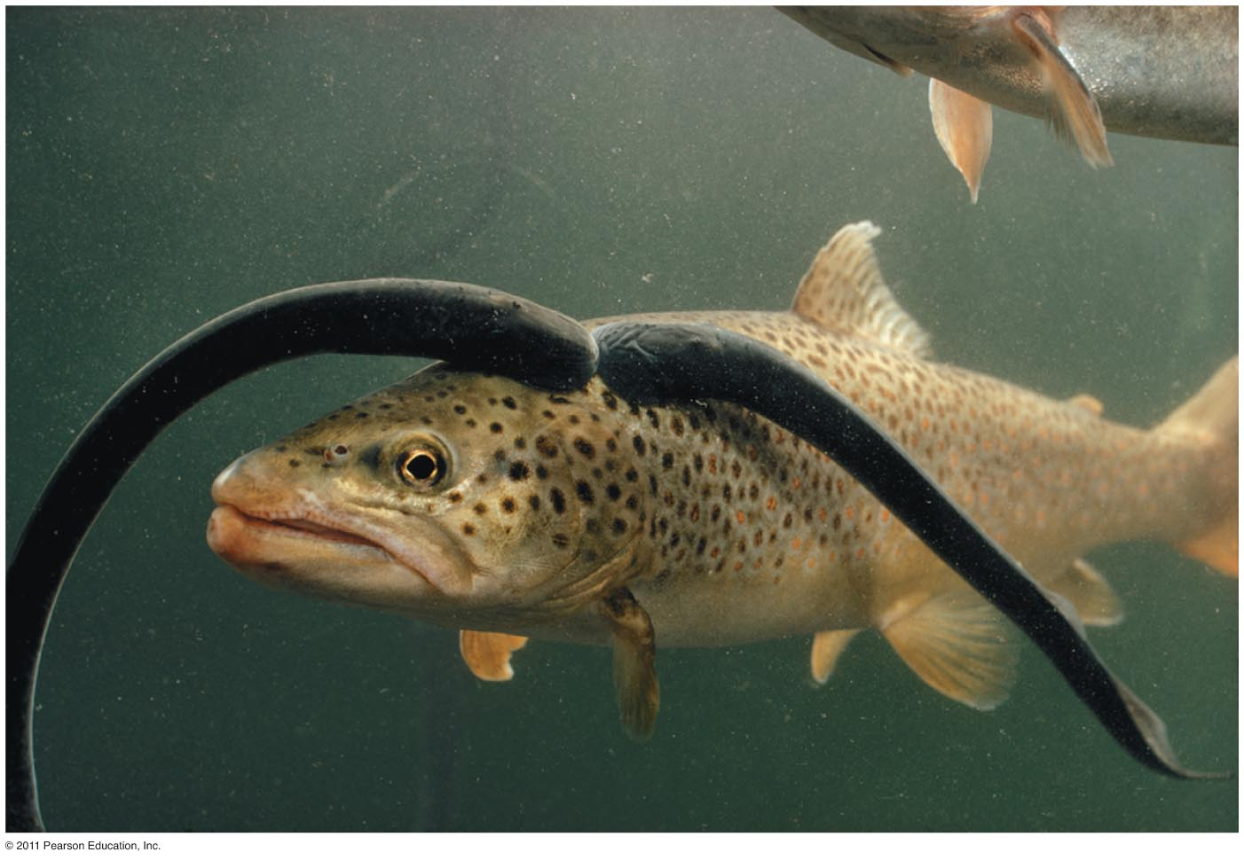
Exploitation: parasitism
Parasitism = a relationship in which one organism (parasite) depends on another (host)
  For nourishment or some other benefit
  The parasite harms, but doesn’t kill, the host
Some are free-living
  Infrequent contact with their hosts
  Ticks, sea lampreys
Some live within the host
  Disease, tapeworms
Notes:
13

Slide 14
Parasites evolve in response to each other
Parasitoids = insects that parasitize other insects
  Killing the host
Coevolution = hosts and parasites become locked in a duel of escalating adaptations
  Has been called an evolutionary arms race
  Each evolves new responses to the other
  It may not be beneficial to the parasite to kill its host
Notes:
14

Slide 15
Mutualism
Two or more species benefit from their interactions
Symbiosis = mutualism in which the organisms live in close physical contact
  Each partner provides a service the other needs (food, protection, housing, etc.)
  Microbes within digestive tracts
  Mycorrhizae: plant roots and fungi
  Coral and algae (zooxanthellae)
Pollination = bees, bats, birds and others transfer pollen from one flower to another, fertilizing its eggs
Notes:
15

Slide 16
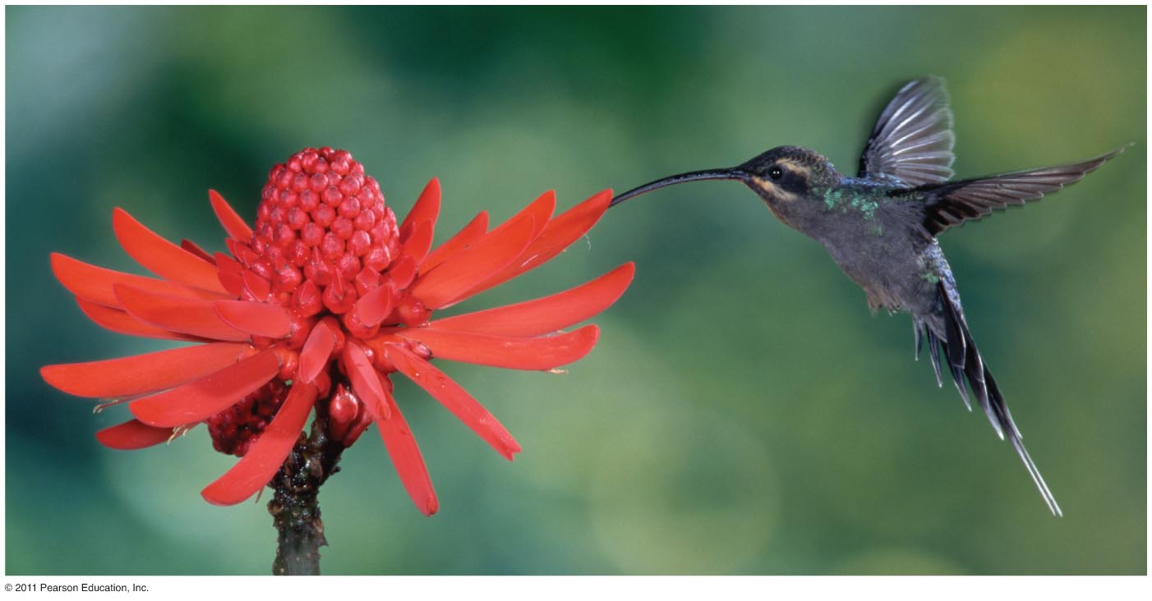
Pollination
In exchange for the plant nectar, the animals pollinate plants, which allows them to reproduce
Notes:
16

Slide 17
Relationships with no effect on one member
Amensalism = a relationship in which one organism is harmed while the other is unaffected
  Difficult to confirm, because usually one organism benefits from harming another
  Allelopathy = certain plants release harmful chemicals
  Or, is this a way to outcompete another for space?
Commensalism = a relationship in which one organism benefits, while the other remains unaffected
Notes:
17

Slide 18
Ecological communities
Community = an assemblage of populations of organisms living in the same place at the same time
  Members interact with each other
  Interactions determine the structure, function, and species composition of the community
Community ecologists are people interested in how:
  Species coexist and relate to one another
  Communities change, and why patterns exist
Notes:
18

Slide 19
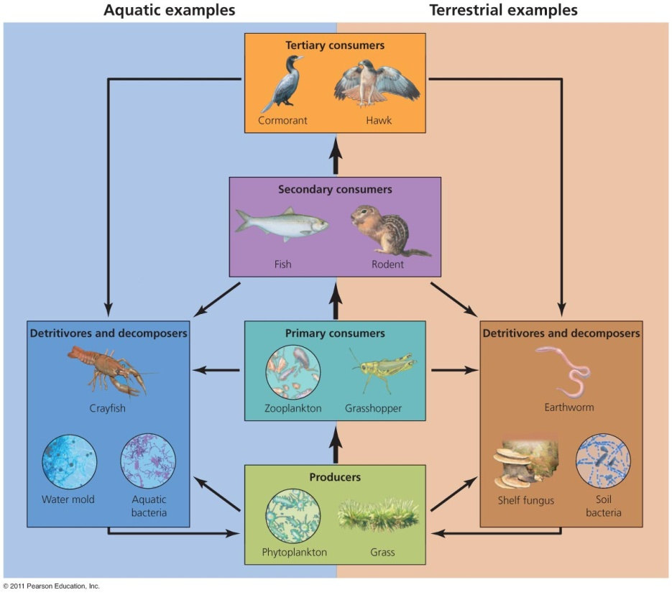
Energy passes through trophic levels
One of the most important species interactions
  Who eats whom?
Matter and energy move through the community
Trophic levels = rank in the feeding hierarchy
  Producers (autotrophs)
  Consumers
  Detritivores and
  decomposers
Notes:
19

Slide 20
Energy, biomass, and numbers decrease
Most energy organisms use is lost as waste heat through cellular respiration
  Less and less energy is available in each successive trophic level
  Each level contains only 10% of the energy of the trophic level below it
There are also far fewer organisms and less biomass (mass of living matter) at the higher trophic levels
A human vegetarian’s ecological footprint is smaller than a meat-eater’s footprint
Notes:
20

Slide 21
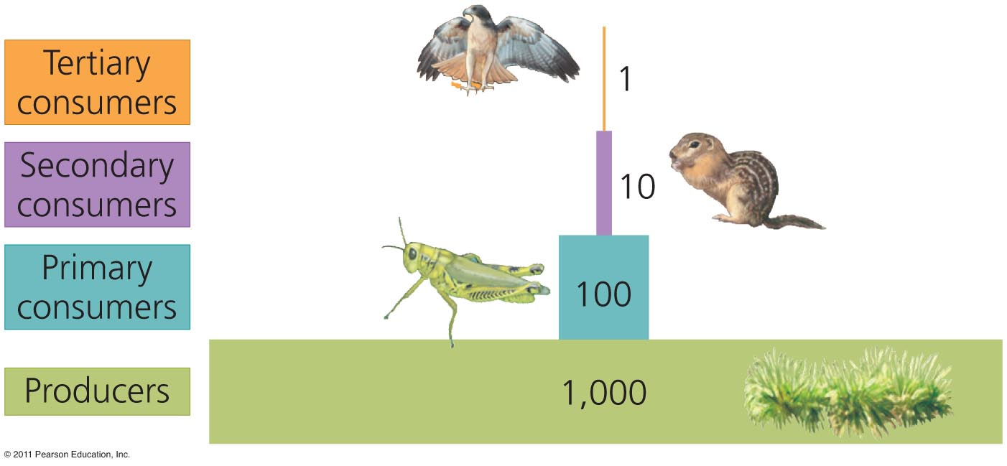
Pyramids of energy, biomass, and numbers

Slide 22
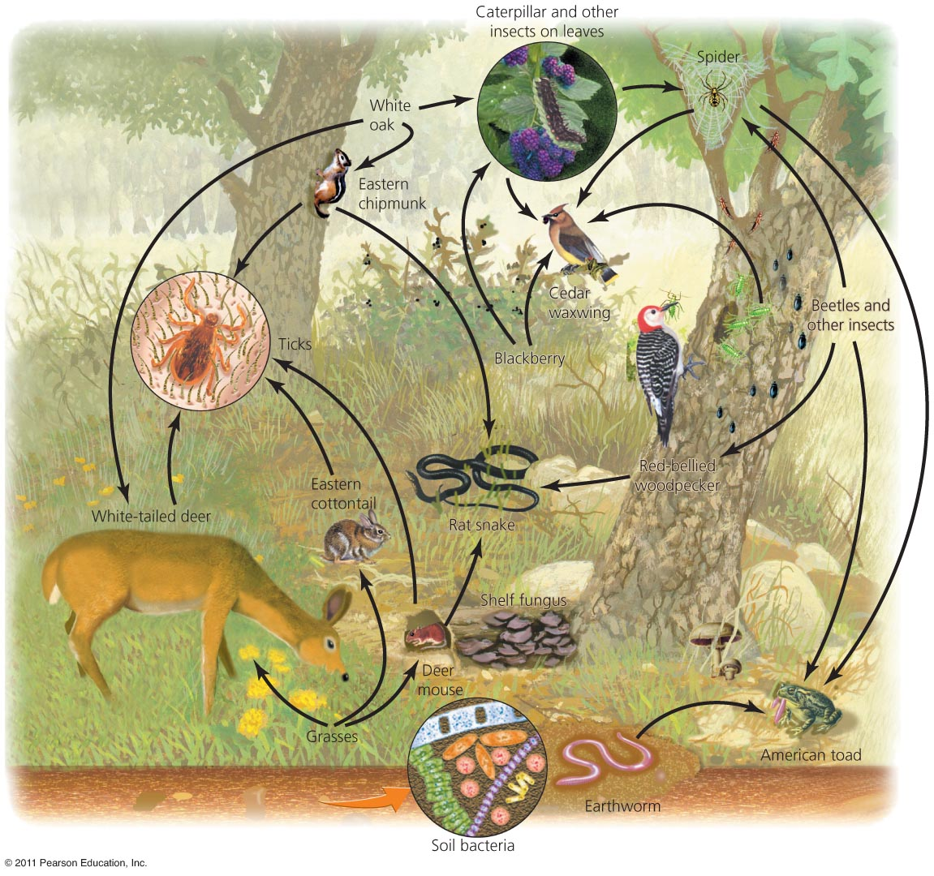
Food webs show relationships and energy flow
Food chain = a series of feeding relationships
Food web = a visual map of feeding relationships and energy flow
  Includes many different
  organisms at all various
  levels
  Greatly simplified; leaves
  out most species
Notes:
22

Slide 23
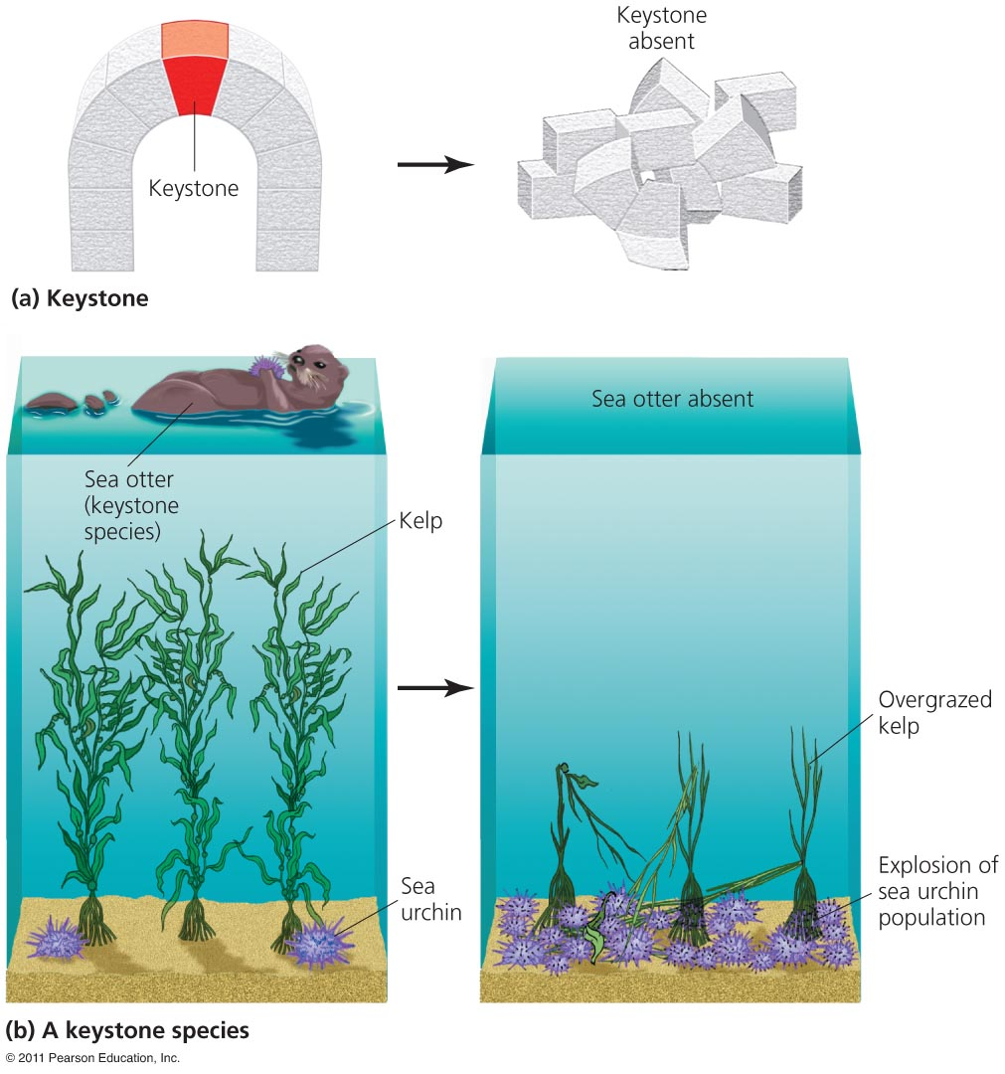
Some organisms play big roles
Community dynamics are complex
  Species interactions differ in strength and over time
Keystone species = has a strong or wide-reaching impact
  Far out of proportion to its abundance
Removal of a keystone species has substantial ripple effects
  Alters the food chain

Slide 24
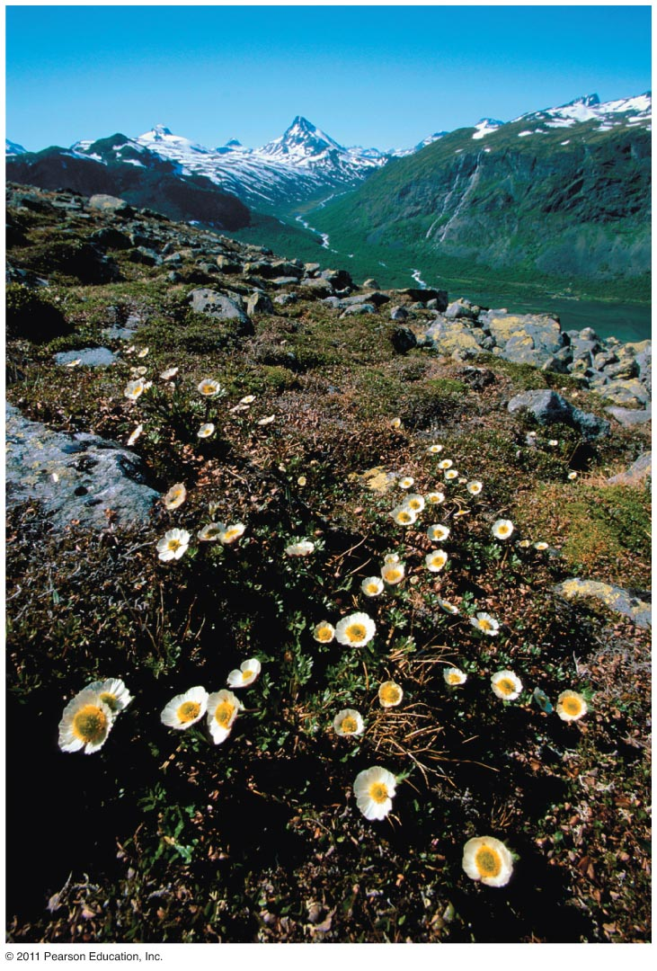
Primary succession
Succession = the predictable series of changes in a community
  Following a disturbance
Primary succession = disturbance removes all vegetation and/or soil life
  Glaciers, drying lakes, volcanic lava
Pioneer species = the first species to arrive in a primary succession area (i.e. lichens)

Slide 25
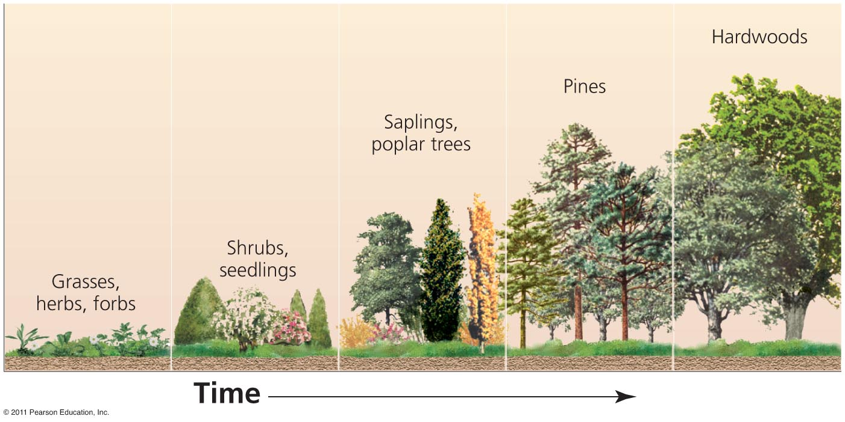
Secondary succession
Secondary succession = a disturbance dramatically alters, but does not destroy, all local organisms
  The remaining organisms form “building blocks” which help shape the process of succession
  Fires, hurricanes, farming, logging
Climax community = remains in place with few changes
  Until another
  disturbance restarts
  succession

Slide 26
Invasive species threaten stability
Invasive species = non-native (exotic) organisms that spread widely and become dominant in a community
  Introduced deliberately or accidentally from elsewhere
  Growth-limiting factors (predators, disease, competitors, etc.) are removed or absent
  They have major ecological effects
  Chestnut blight from Asia wiped out American chestnut trees
Some species help people (i.e., European honeybees)

Slide 27
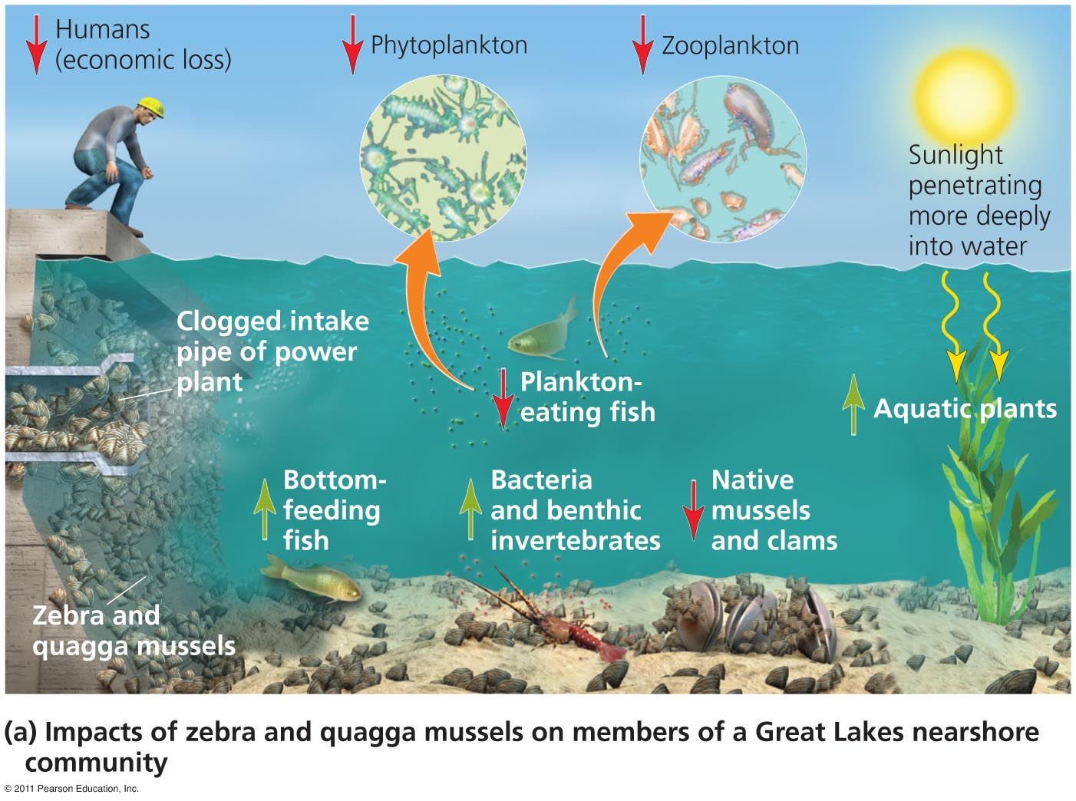
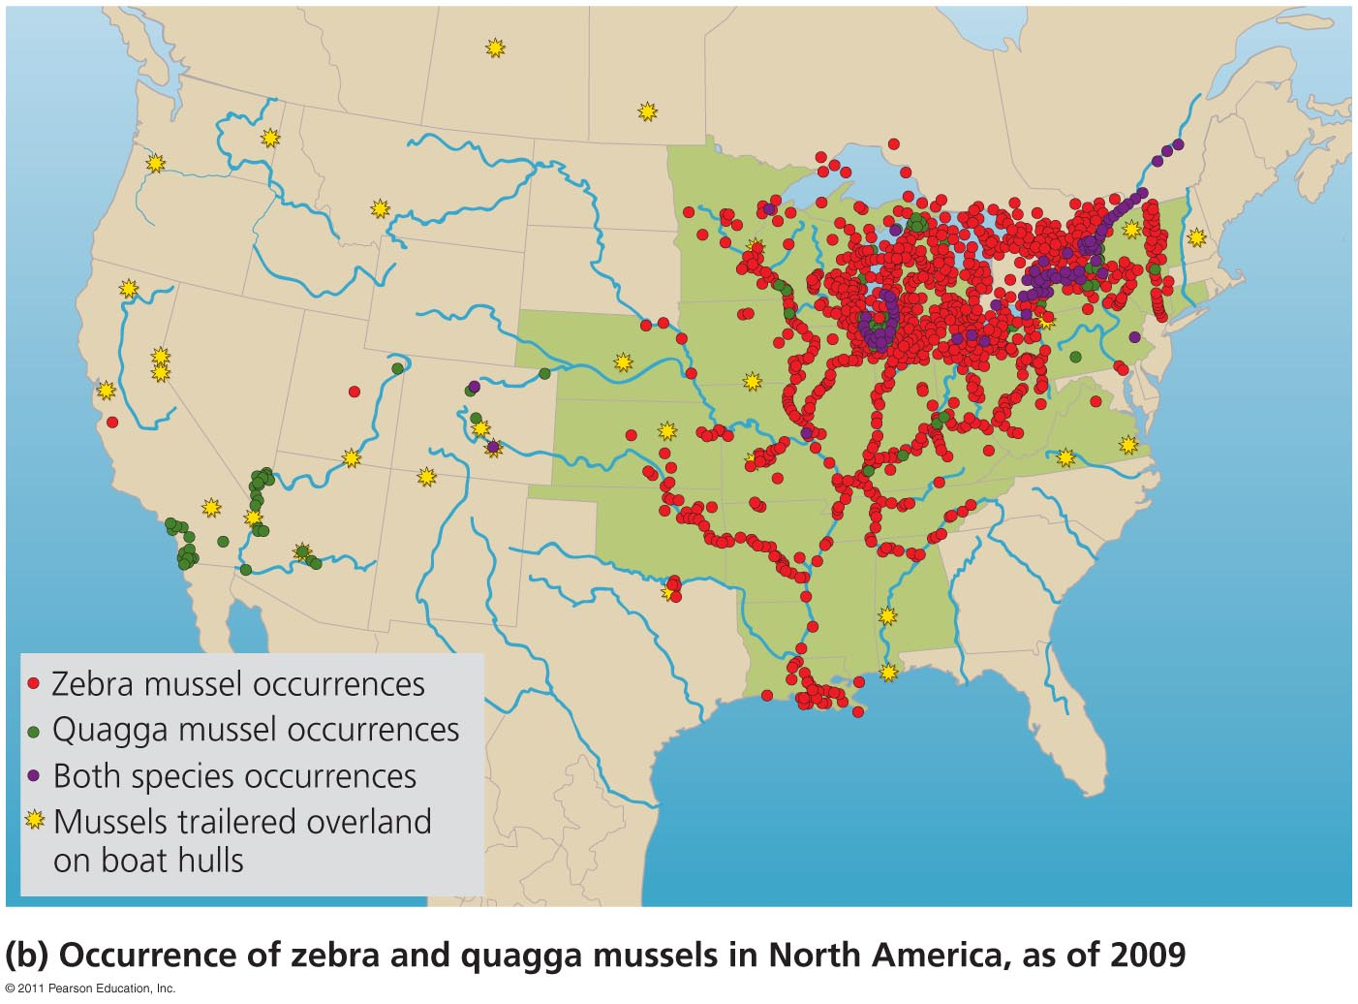
Two invasive mussels

Slide 28
Controlling invasive species
Techniques to control invasive species
  Removing them manually
  Applying toxic chemicals
  Drying them out
  Depriving them of oxygen
  Stressing them with heat, sound, electricity, carbon dioxide, or ultraviolet light
Control and eradication are hard and expensive
Prevention, rather than control, is the best policy

Slide 29
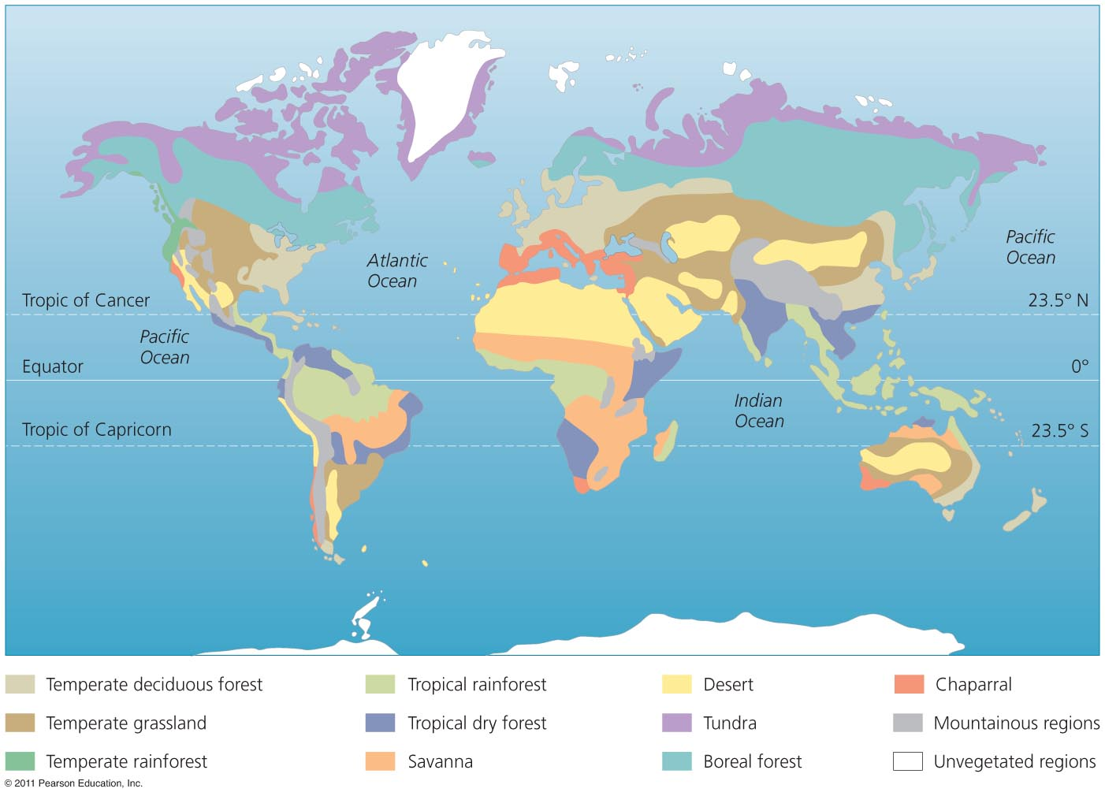
Widely separated regions share similarities
Biome = major regional complex of similar communities recognized by
  Plant type
  Vegetation
  structure

Slide 30
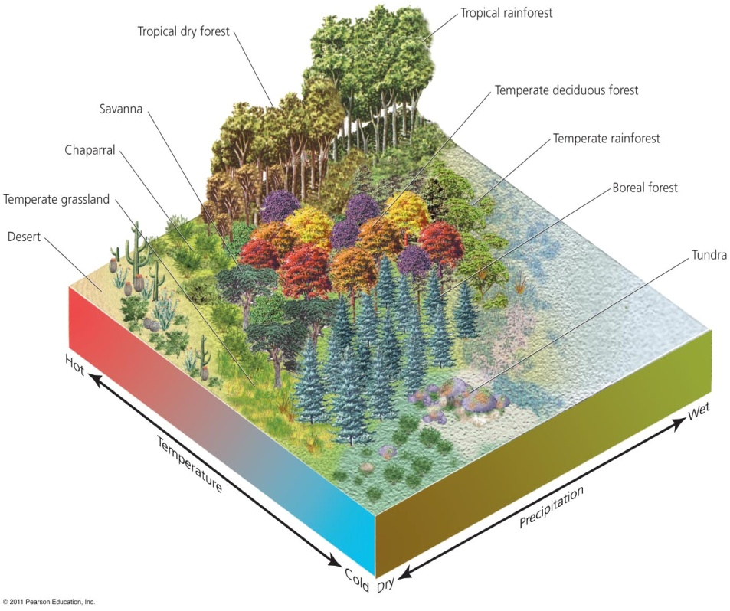
Multiple factors determine a biome
The type of biome depends on abiotic factors
  Temperature, precipitation, soil type, atmospheric circulation
Climatographs = a climate diagram showing
  An area’s mean monthly temperature and precipitation
  Similar biomes occupy similar latitudes

Slide 31
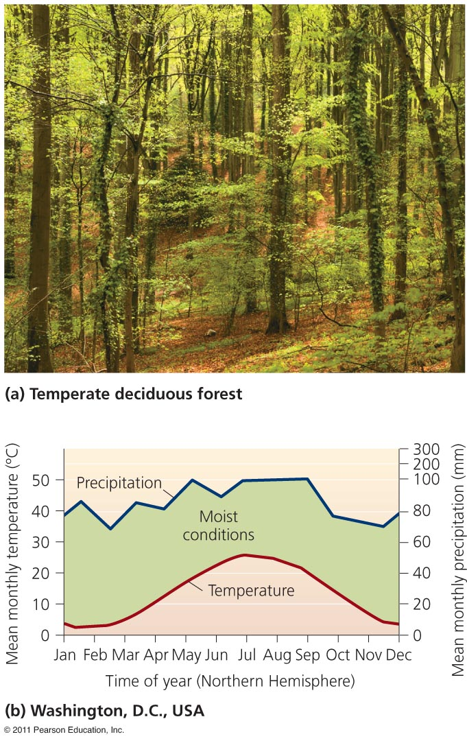
Temperate deciduous forest
Deciduous trees lose their leaves each fall
  They remain dormant during winter
Mid-latitude forests in Europe, East China, Eastern North America
Even, year-round precipitation
Fertile soils
Forests = oak, beech, maple

Slide 32
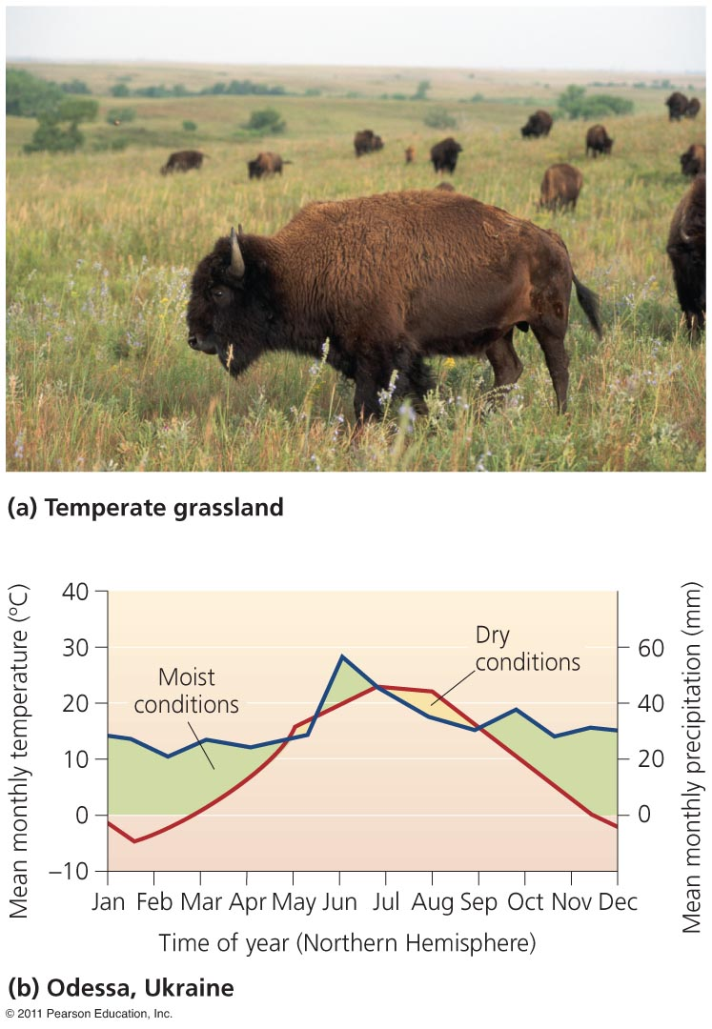
Temperate grasslands
More extreme temperature difference
  Between winter and summer
Less precipitation
Also called steppe or prairie
  Once widespread, but has been converted to agriculture
  Bison, prairie dogs, ground-nesting birds, pronghorn

Slide 33
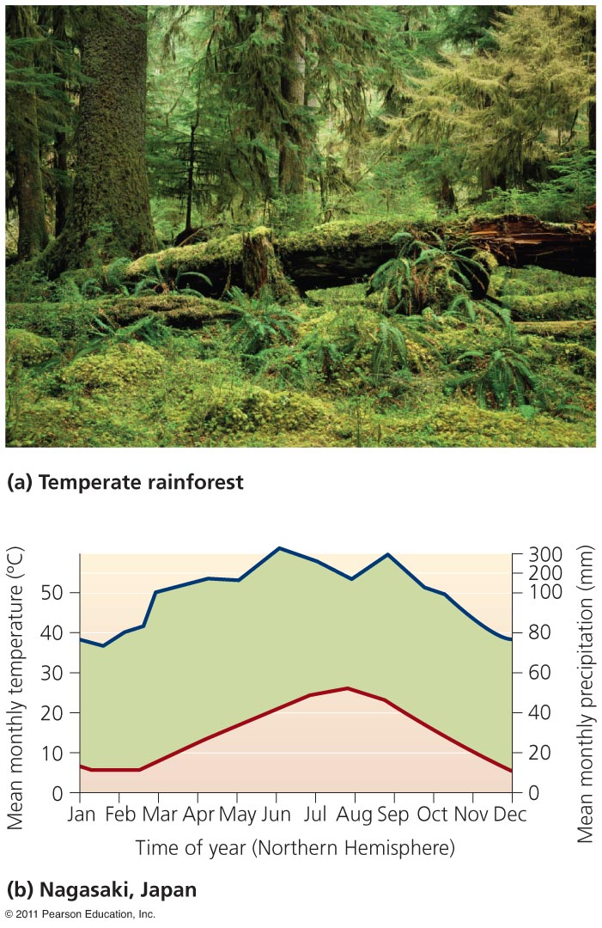
Temperate rainforest
Coastal Pacific Northwest
Great deal of precipitation
Coniferous trees: cedar, spruce, hemlock, fir
Moisture-loving animals
  Banana slug
Erosion and landslides affect the fertile soil
Lumber and paper
Most old-growth is gone

Slide 34
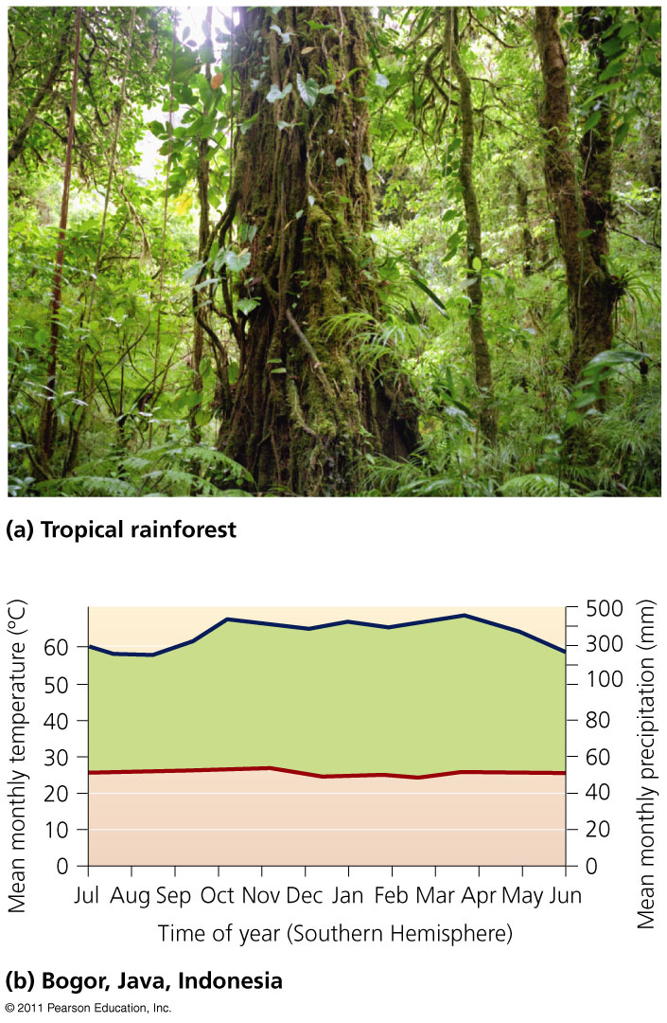
Tropical rainforest
Southeast Asia, west Africa Central and South America
Year-round rain and warm temperatures
Dark and damp
Lush vegetation
Diverse species
  But in low densities
Very poor, acidic soils

Slide 35
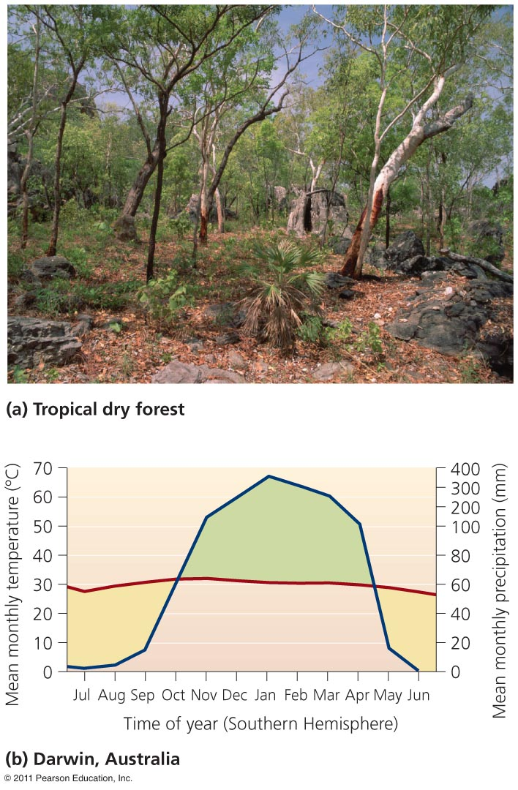
Tropical dry forest
Also called tropical deciduous forest
  Plants drop leaves during the dry season
India, Africa, South America, north Australia
Wet and dry seasons
Warm, but less rainfall
Converted to agriculture
  Severe soil erosion

Slide 36
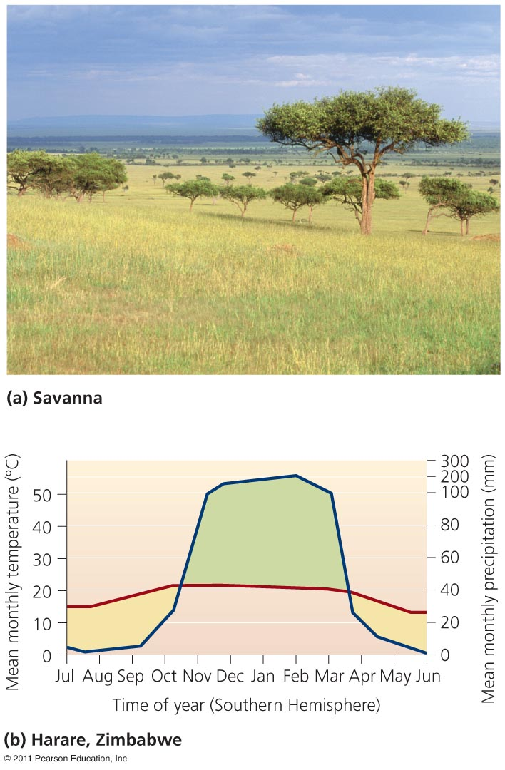
Savanna
Grassland interspersed with trees
Africa, South America, Australia, India
Precipitation is only during the rainy season
Animals gather near water holes
Zebras, gazelles, giraffes, lions, hyenas

Slide 37
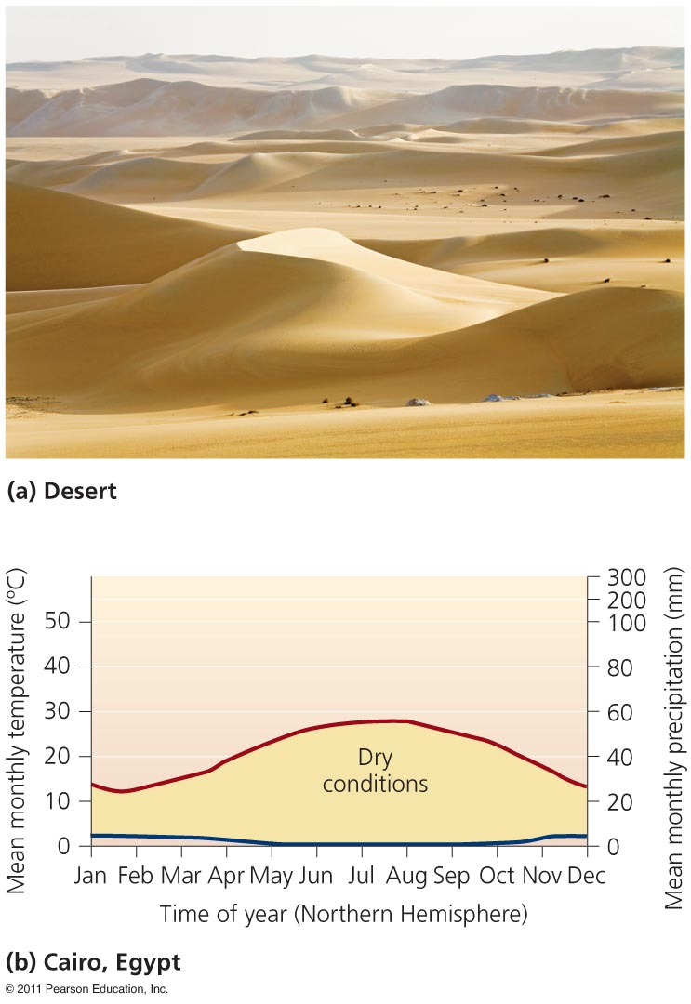
Desert
Minimal precipitation
Some are bare, with sand dunes (Sahara)
Some are heavily vegetated (Sonoran)
They are not always hot
  Temperatures vary widely
Saline soils
Animals = nocturnal, nomadic
Plants = thick skins, spines

Slide 38
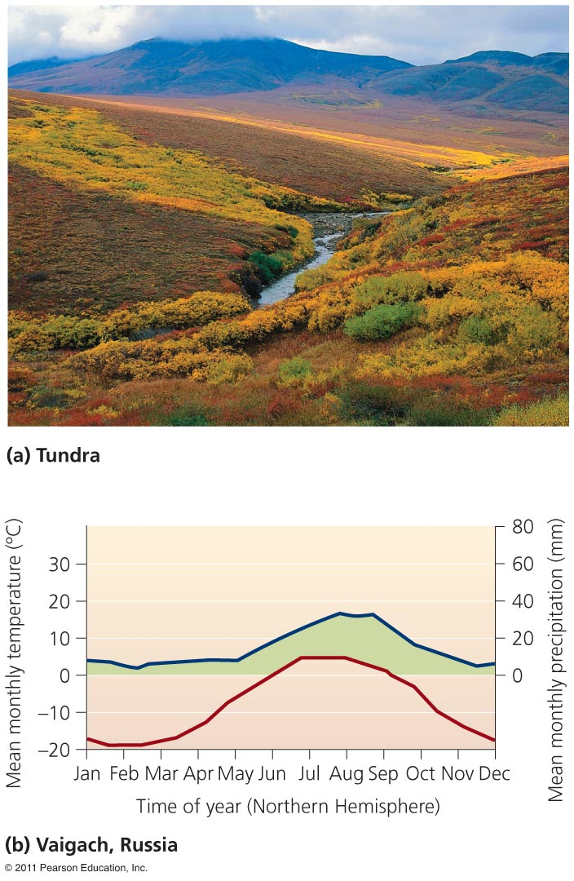
Tundra
Russia, Canada, Scandinavia
Minimal precipitation
Extremely cold winters
Permafrost = permanently frozen soil
  Melting due to climate change
Few animals: polar bears, musk oxen, caribou, migratory birds
Lichens, low vegetation, few trees

Slide 39
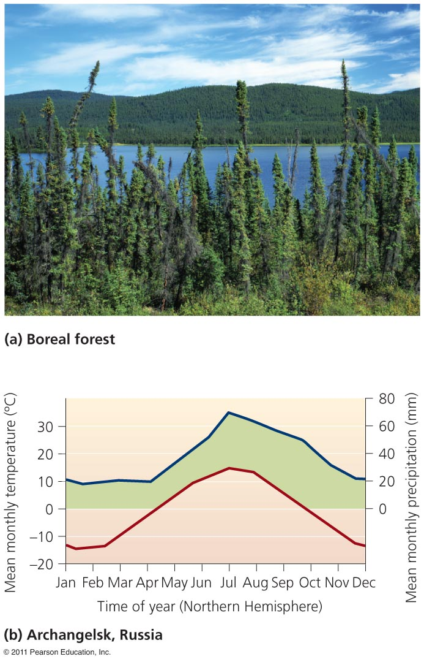
Boreal forest (taiga)
Canada, Alaska, Russia, Scandinavia
A few evergreen tree species
Cool and dry climate
  Long, cold winters
  Short, cool summers
Nutrient poor, acidic soil
Moose, wolves, bears, lynx, migratory birds

Slide 40
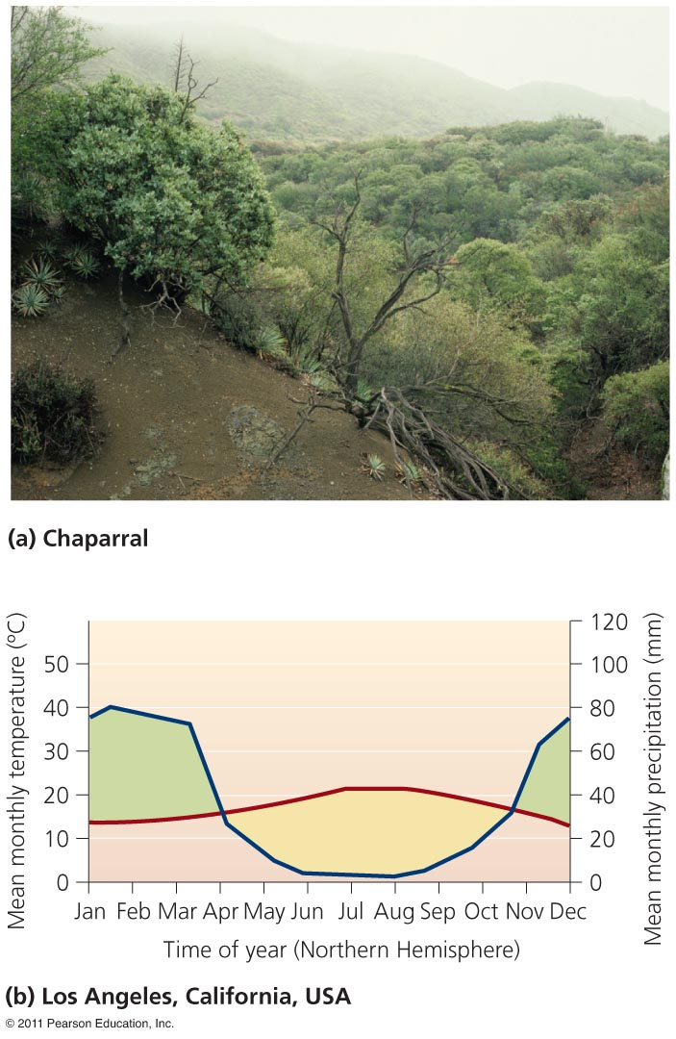
Chaparral
Occurs in small patches around the globe
Mediterranean Sea, Chile, California, south Australia
High seasonal biome
  Mild, wet winters
  Warm, dry summers
Frequent fires
Densely thicketed, evergreen shrubs

Slide 41
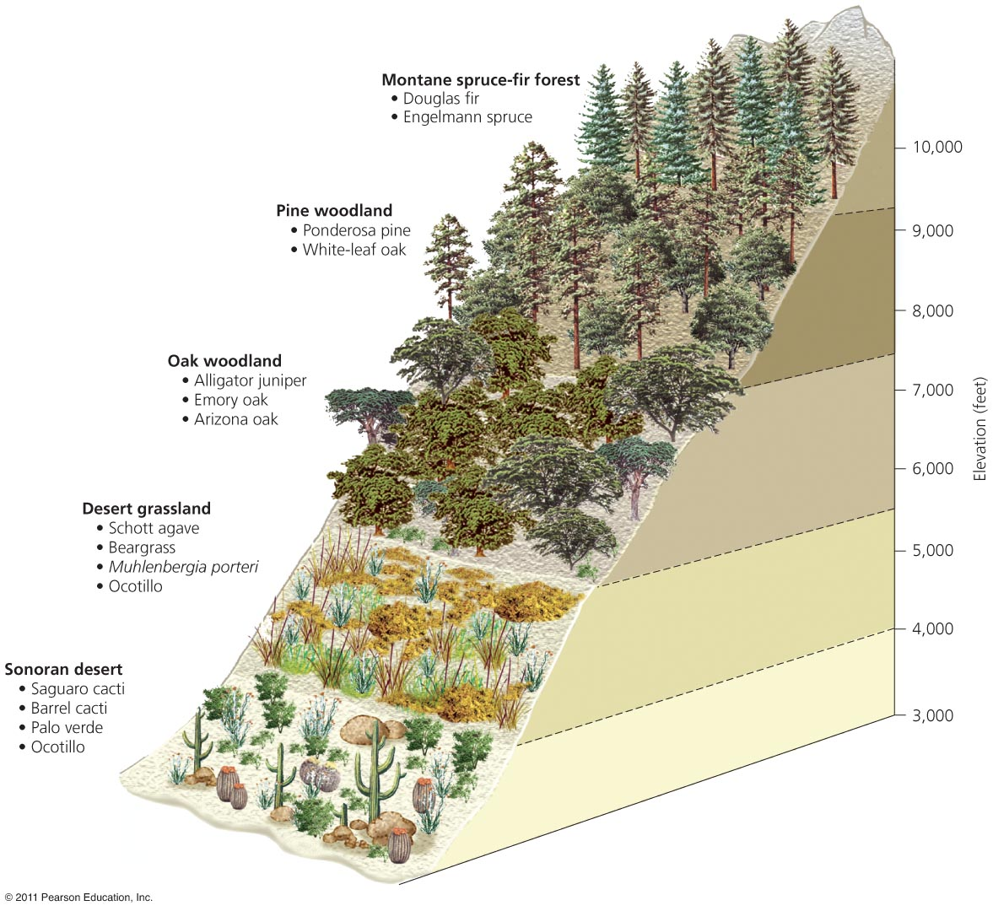
Altitudes create “latitudinal patterns”
Vegetative communities rapidly change along mountain slopes
The climate varies with altitude
A mountain climber in the Andes
  Begins in the tropics and ends
  on a glacier
Rainshadow effect = air going
over a mountain releases
moisture
  Creating an arid region
  on the other side
  Hiking up a mountain in the southwest U.S. is like walking from Mexico to Canada

Slide 42
Systems are perceived in various ways
Categorizing environmental systems helps make Earth’s dazzling complexity comprehensible
For example, the Earth consists of structural spheres
  Lithosphere = rock and sediment
  Atmosphere = the air surrounding our planet
  Hydrosphere = liquid, solid or vapor water
  Biosphere = the planet’s living organisms and the abiotic (nonliving) portions of the environment
Boundaries overlap, so the systems interact

Slide 43
Ecosystems
Ecosystem = all organisms and nonliving entities that occur and interact in a particular area at the same time
  It includes abiotic and biotic components
Biological entities are tightly intertwined with chemical and physical entities
  Through interactions and feedback loops
Ecosystems receive, process and transform inputs of energy
  While cycling and recycling matter
  Outputs produced include heat, water, wastes
Notes:
43
43

Slide 44
Energy is converted to biomass
Primary production = conversion of solar energy to chemical energy in sugars by autotrophs
Gross primary production (GPP) = assimilation of energy by autotrophs
Net primary production (NPP) = energy remaining after respiration which is used to generate biomass
  Available for consumption by heterotrophs
Secondary production = biomass generated by heterotrophs from consuming autotrophs
Productivity = rate at which ecosystems generate biomass
Notes:
44
44

Slide 45
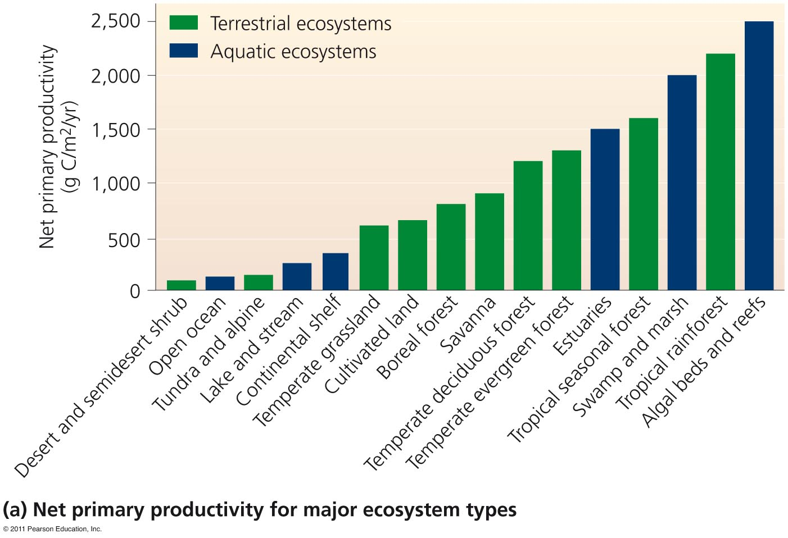
Net primary productivity of ecosystems
High net primary productivity = ecosystems whose plants rapidly convert solar energy to biomass

Slide 46
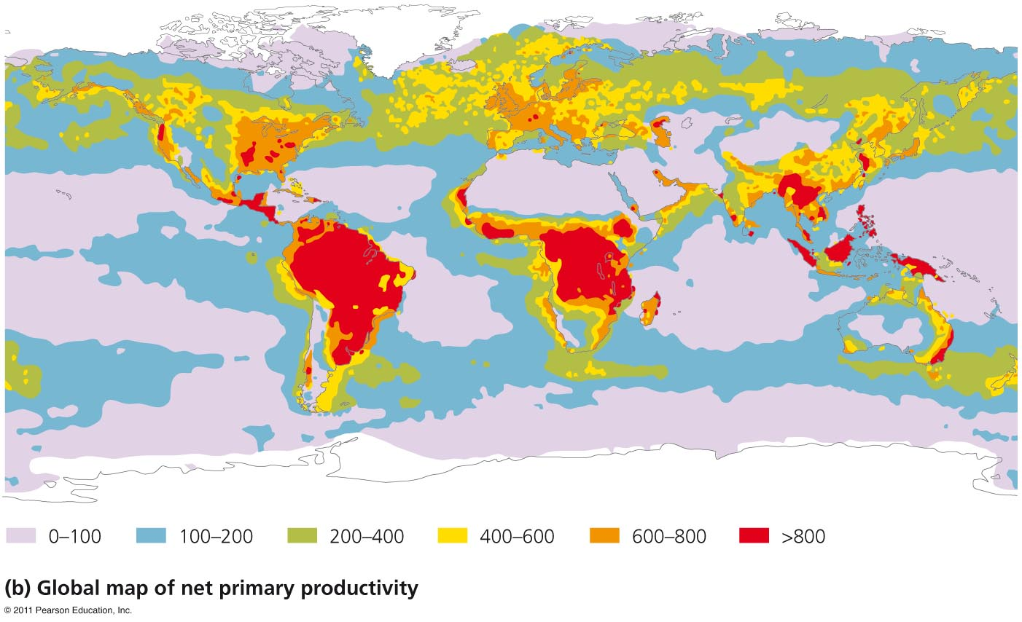
NPP variation causes global geographic patterns
NPP increases with temperature and precipitation on land, and with light and nutrients in aquatic ecosystems

Slide 47
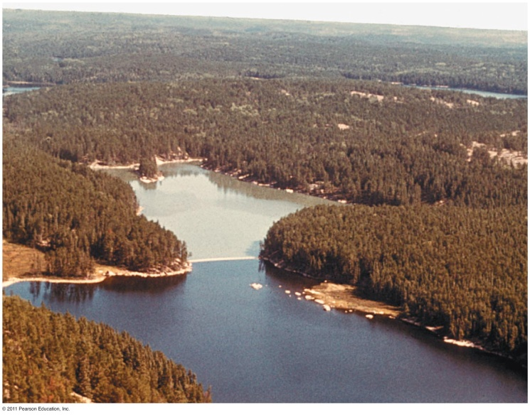
Nutrients can limit productivity
Nutrients = elements and compounds required for survival that are consumed by organisms
Macronutrients = required in larger amounts
  Nitrogen, carbon, phosphorus
Micronutrients = nutrients needed in smaller amounts
Nutrients stimulate plant production
  Nitrogen and phosphorus are important for plant and
  algal growth
Dramatic growth of algae in water treated with phosphate
Notes:
47
47

Slide 48
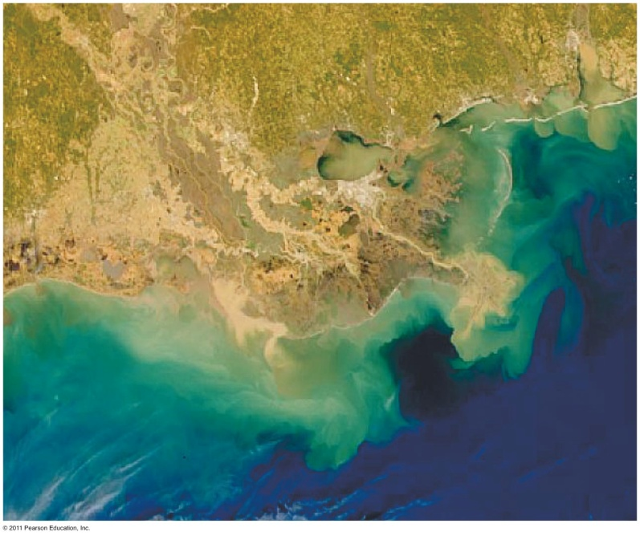
Nutrient runoff is devastating aquatic systems
Nitrogen is the more important limiting factor for primary productivity
  In coastal ocean waters
  Iron is an effective nutrient for open ocean waters
Satellite imagery gives scientists an improved view of productivity at regional and global scales
Phytoplankton blooms off the Louisiana coast

Slide 49
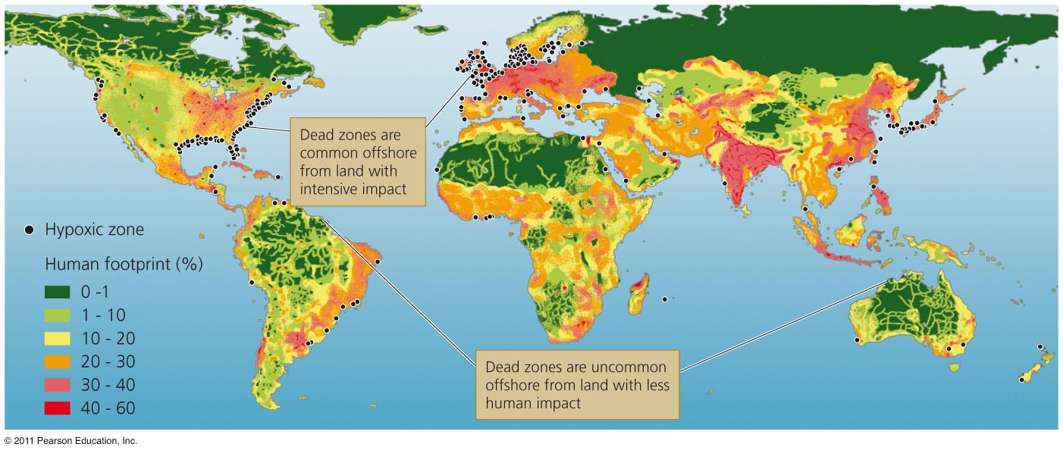
Worldwide marine dead zones
Over 400 dead zones occur globally
  Most are off the coasts of Europe and the U.S.
  Mostly due to farm, city and industrial pollution
  Some are seasonal, others are permanent
Fisheries and ecosystems are devastated
  Causing over $2 billion/year in lost harvests

Slide 50
Ecosystems provide vital services
Human society depends on healthy, functioning ecosystems
  They provide goods and services we need to survive
Ecosystem services = provided by the planet’s systems
  Soil formation, water and air purification, pollination
  Breakdown of some pollutants and waste
  Quality of life issues (inspiration, spiritual renewal)
  Nutrient cycling

Slide 51
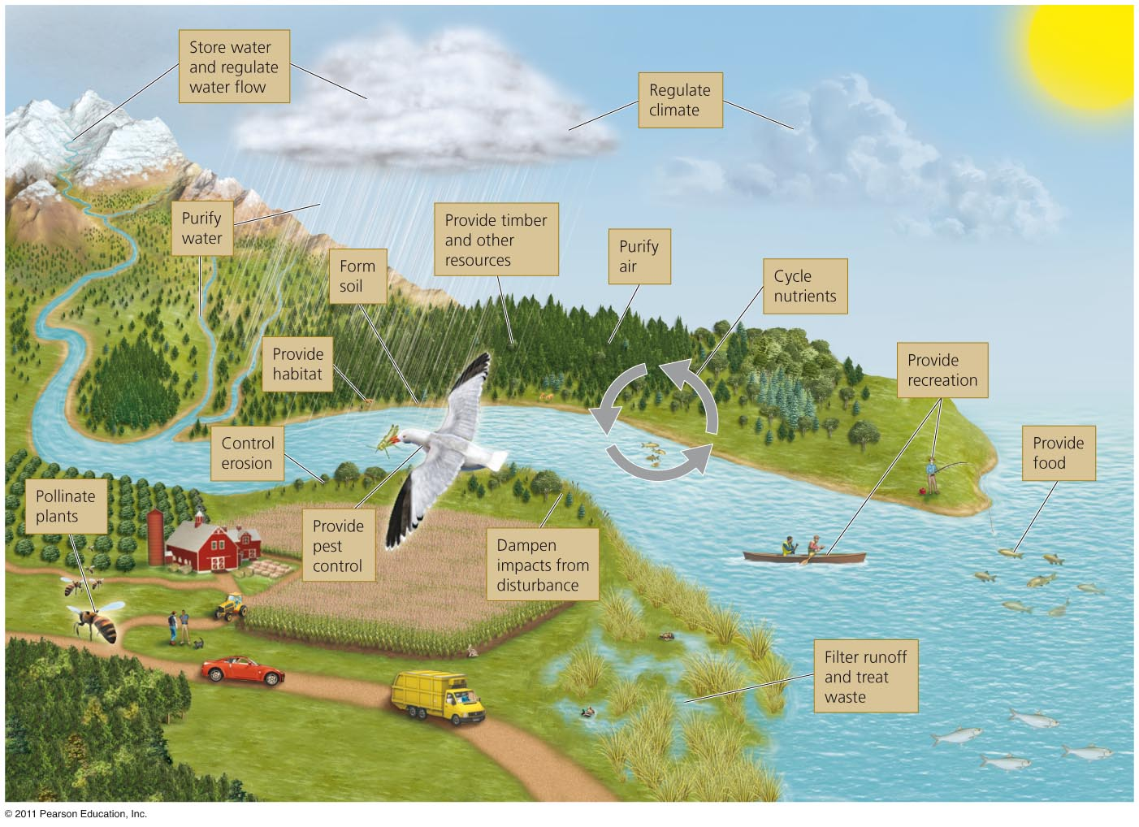
Ecosystem goods and services

Slide 52
Nutrients circulate through ecosystems
Matter is continually circulated in ecosystems
Nutrient (biogeochemical) cycles = the movement of nutrients through ecosystems
  Atmosphere, hydrosphere, lithosphere, and biosphere
Pools (reservoirs) = where nutrients reside for varying amounts of time (the residence time)
Flux = the rate at which materials move between pools
  Can change over time
  Is influenced by human activities
Notes:
52
52

Slide 53
The hydrologic cycle
Water is essential for biochemical reactions
  It is involved in nearly every environmental system
Hydrologic cycle = summarizes how liquid, gaseous and solid water flows through the environment
  Oceans are the main reservoir
Evaporation = water moves from aquatic and land systems into the atmosphere
Transpiration = release of water vapor by plants
Precipitation, runoff, and surface water = water returns to Earth as rain or snow and flows into streams, oceans, etc.

Slide 54
Groundwater
Aquifers = underground reservoirs of sponge-like regions of rock and soil that hold…
  Groundwater = water found underground beneath layers of soil
Water table = the upper limit of groundwater in an aquifer
  Water may be ancient (thousands of years old)
Groundwater becomes exposed to the air where the water table reaches the surface
  Exposed water runs off to the ocean or evaporates

Slide 55
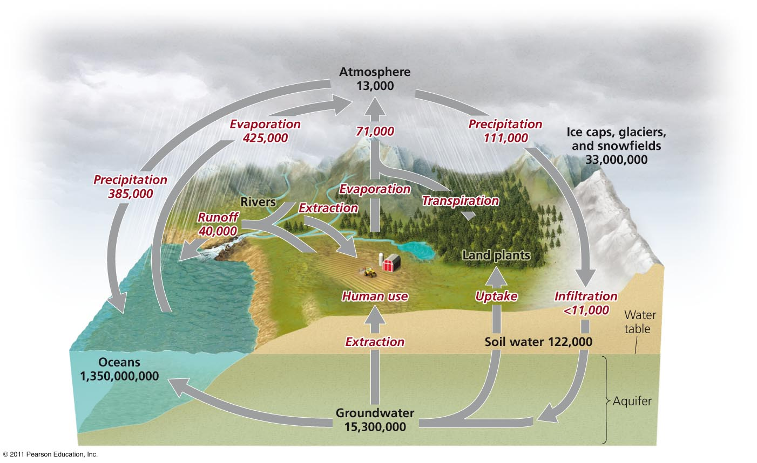
The hydrologic cycle

Slide 56
The carbon cycle
Carbon is found in carbohydrates, fats, proteins, bones, cartilage and shells
Carbon cycle = describes the route of carbon atoms through the environment
Photosynthesis by plants, algae and cyanobacteria
  Removes carbon dioxide from air and water
  Produces oxygen and carbohydrates
  Plants are a major reservoir of carbon
Respiration returns carbon to the air and oceans
  Plants, consumers and decomposers
Notes:
56
56

Slide 57
Sediment storage of carbon
Decomposition returns carbon to the sediment
  The largest reservoir of carbon
  May be trapped for hundreds of millions of years
Aquatic organisms die and settle in the sediment
  Older layers are buried deeply and undergo high pressure
  Ultimately, it may be converted into fossil fuels
Oceans are the second largest reservoir of carbon

Slide 58
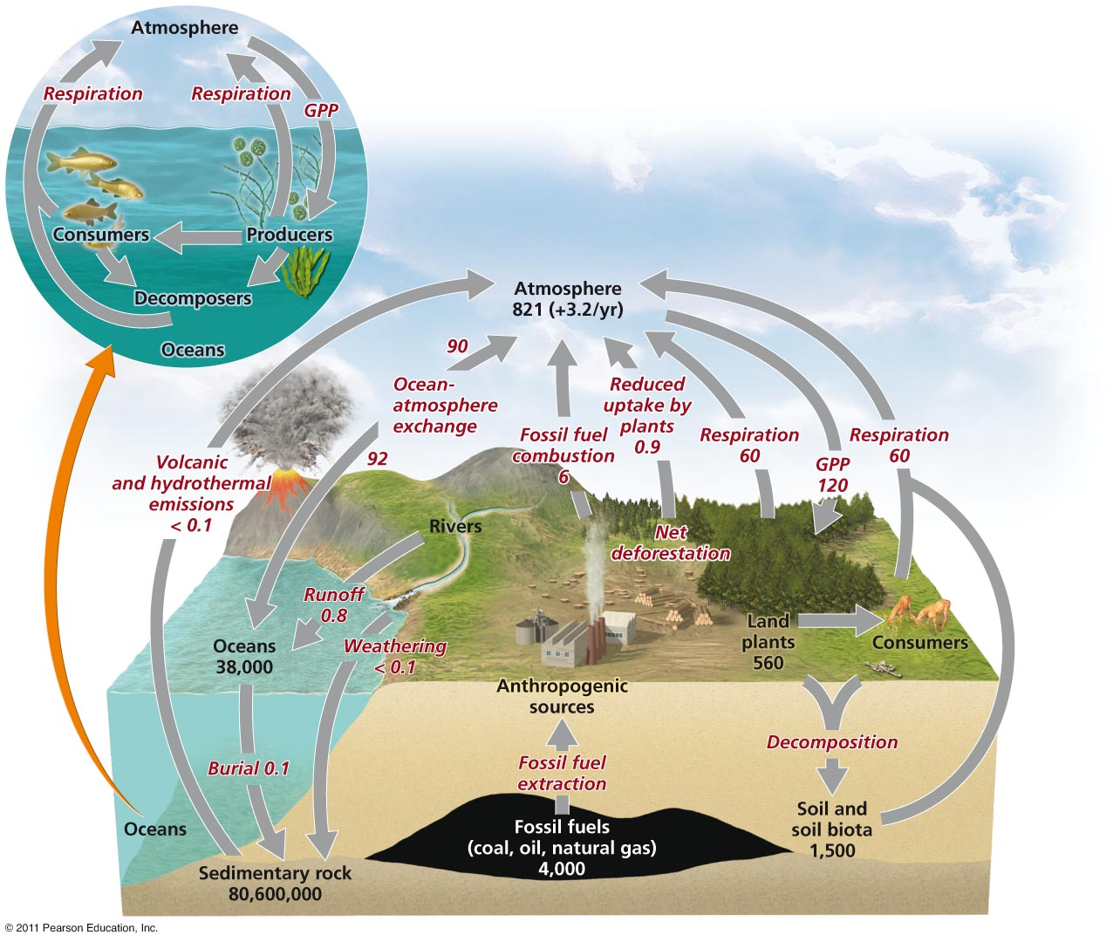
The carbon cycle

Slide 59
The nitrogen cycle
Nitrogen comprises 78% of our atmosphere
  It is contained in proteins, DNA and RNA
Nitrogen cycle = describes the routes that nitrogen atoms take through the environment
  Nitrogen gas cannot be used by organisms
Nitrogen fixation = lightning or nitrogen-fixing bacteria combine (fix) nitrogen with hydrogen
  To form ammonium
  Which can be used
  by plants

Slide 60
Nitrification and denitrification
Nitrification = bacteria convert ammonium ions first into nitrite ions then into nitrate ions
  Plants can take up these ions
Animals obtain nitrogen by eating plants or other animals
Decomposers get it from dead and decaying plants or other animals
  Releasing ammonium ions to nitrifying bacteria
Denitrifying bacteria = convert nitrates in soil or water to gaseous nitrogen
  Releasing it back into the atmosphere

Slide 61
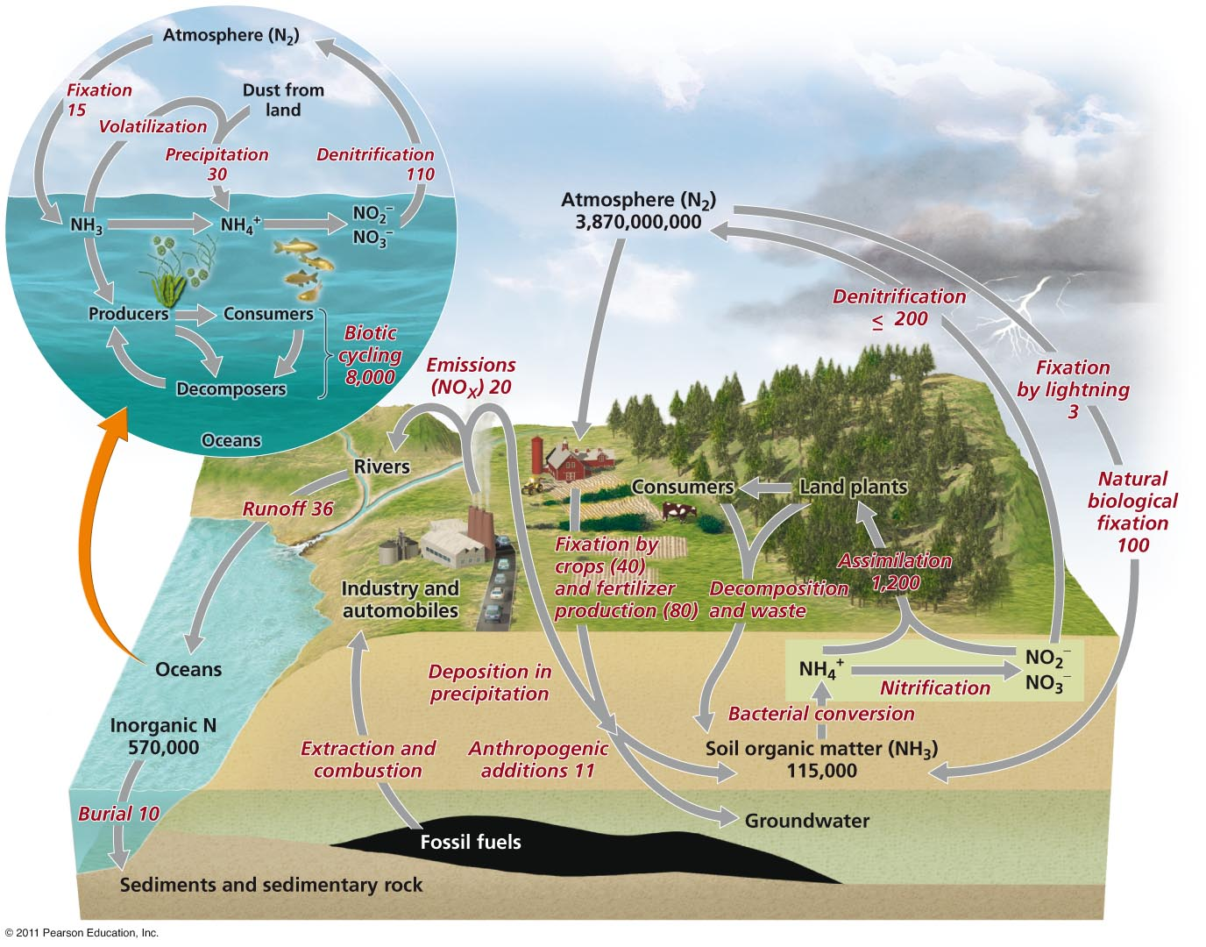
The nitrogen cycle

Slide 62
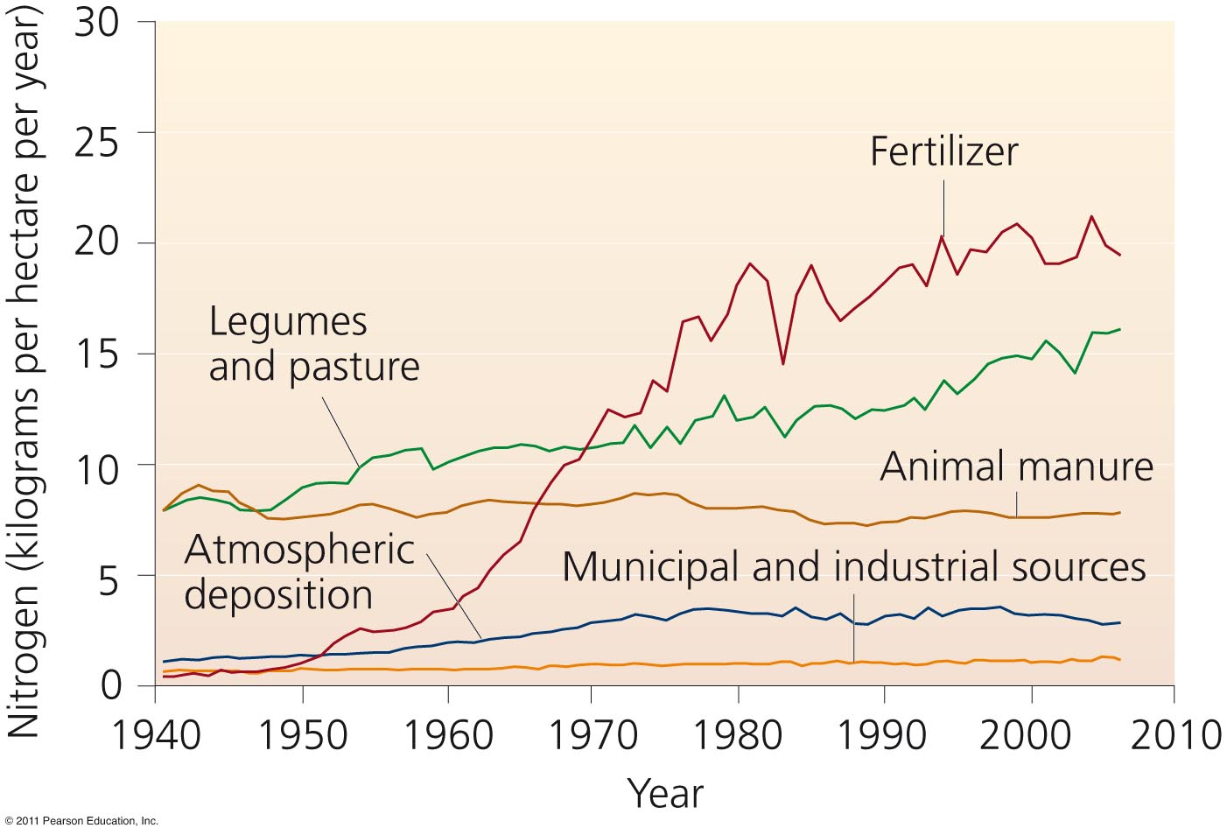
Humans put nitrogen into the environment
Fully half of nitrogen entering the environment is of human origin

Slide 63
The phosphorus cycle
Phosphorus (P) is a key component of cell membranes, DNA, RNA, ATP and ADP
Phosphorus cycle = describes the routes that phosphorus atoms take through the environment
Most phosphorus is within rocks
  It is released by weathering
  There is no significant atmospheric component
With naturally low environmental concentrations
  Phosphorus is a limiting factor for plant growth

Slide 64
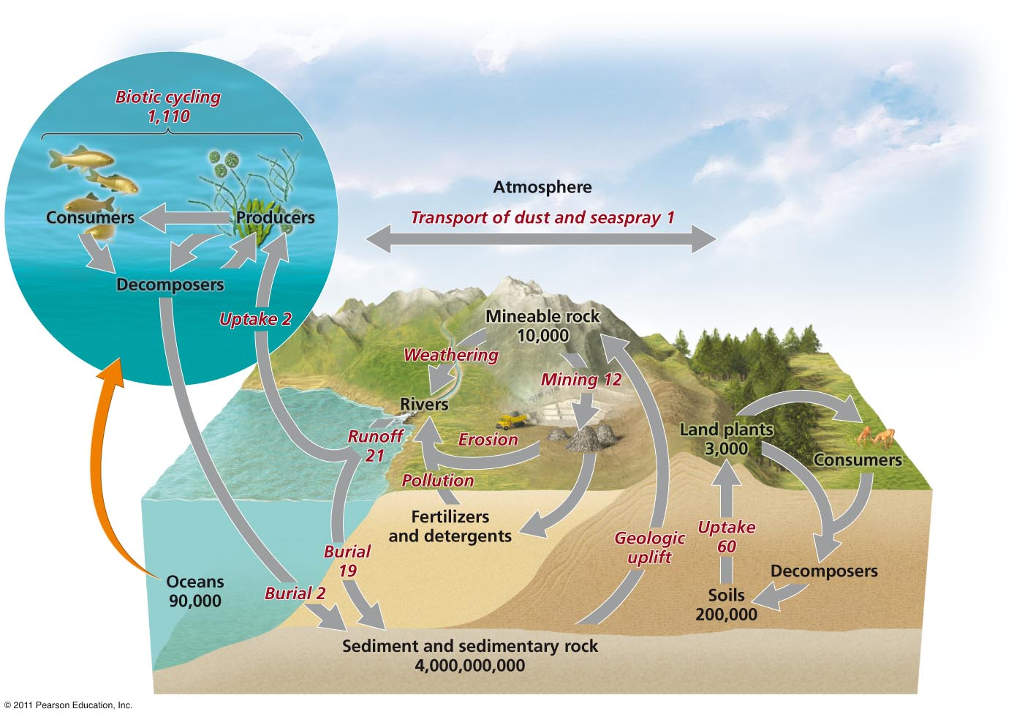
The phosphorus cycle

